Slide 1

Bus Service Management
By Muhammad Uzair & Sikandar Ifthikhar

Slide 2
Description:
We have developed a Bus Service Project ,this program have some features for Company which is providing bus services , like they will install or set complete information about buses Simultaneously , On the other hand this program give feasibility to general public for reservation of bus seats according to seat numbers , Bus availability Check , Arrival & Departure checking , and all complete info about buses to reserve tickets online. These kinds of Codes are working behind different bus services companies, not only in Pakistan but also same kind of programs are used worldwide.

Slide 3
Program Structure:
Here we have used Classes to call different functions to display every information in a professional way like , Displaying Information, Reservations, Availability Check, and we have used Pointer to make Arrays Dynamically according to our need. And the entire program is performed by using Conditional Statements and Loops. Copy Constructor is also used to copy data from one section to other sections. All the data is going to save in File (.txt format) using File Handling Concept.

Slide 4
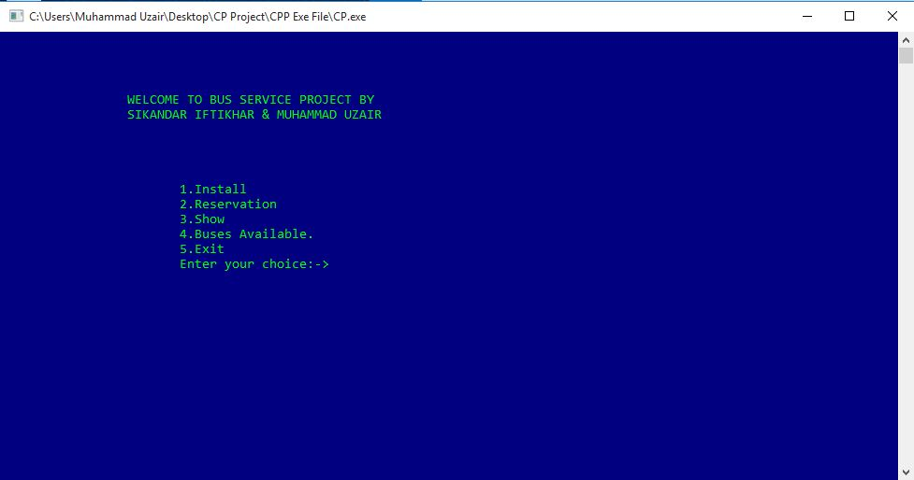
Layout

Slide 5
Thank You
Any Question ?

